Slide 1
Privacy Issues in Social Networks
Dr. Bhawana Rudra
NITK

Slide 2
Disclaimer: The information is gathered from various sources of the Web

Slide 3
Introduction
Introduction to Computer Networks
Social Networks
Online Social Networks(OSNs)
Ethical and Privacy Issues in Online Social Networks
Security and Crimes in Online Social Networks
Proven Security Protocols and Best Practices in Online Social Networks

Slide 4
Online Crimes
An online crime is a crime like any other crime, except it involves a connected computing system either as an object of a crime, an instrument used to commit a crime or a repository of evidence related to a crime.
The International Convention of Cyber Crimes and the European Convention on Cyber Crimes both list the following crimes as online crime [1]:
Unlawful access to information
Illegal interception of information
Unlawful use of telecommunication equipment.
Forgery with use of computer measures
Intrusions of the Public Switched and Packet Network
Network integrity violations
Privacy violations
Industrial espionage
Pirated computer software
Fraud using a computing system
Internet/email abuse
Using computers or computer technology to commit murder, terrorism, pornography, and hacking.

Slide 5
Ways to Perpetuate Online Crimes
System penetration - a process of gaining unauthorized access to a protected system’s resources, the system may be automated or not.
Distributed Denial of Service (DDoS) - an interruption of service of the target system – when it is made either unavailable to users through disabling or destruction of it.
Category include:
IP-spoofing
SYN-Flooding:
Smurf attack
Buffer Overflow
Ping of Death
Land.c attack
Teardrop.c
Sequence Number Sniffing

Slide 6
Defense Against Online Crimes
Prevention – one of the oldest and probably the best defence mechanism against online crimes. Must include the following:
A security policy
Risk management
Vulnerability assessment
Use of strong cryptographic algorithms
Penetration testing
Regular audits
Use of proven security protocols
Legislation
Self-regulation
Mass education

Slide 7
Proven Security Protocols and Best Practices
There are hundreds of security protocols and best practices in use today
The problem for security professional is to find the best
Major categories are:

Slide 8
Authentication - a process of validating the identity of someone or something.
uses information provided to the authenticator to determine whether someone or something is in fact who or what it is declared to be.
requires one to present credentials or items of value to the authenticating agent in order to prove the claim of who one really is.
items of value or credential are based on: something you know, something you have, or something you are:
Something you know: may be something you mentally possess like a password, a secret word known by the user and the authenticator. This technique of authentication is cheap but has weaknesses like memory lapses.

Slide 9
Something you have:, may be any form of issued or acquired self identification such as SecurID, Activcard, or any other forms of cards and tags. This authentication technique is slightly safer.
Something you are: These are individual physical characteristic such as voice, fingerprint, iris pattern and other biometrics. Biometric authentication as we are going to see in Chapter 14 are the safest form of authentication.
Authentication methods include:
password
public-key
anonymous
certificate-based

Slide 10
Access Control - a process of determining how access to the system’s potential resources can be provided to each of the system users.
Several control techniques and technologies have been developed to deal with this problem; they include: Access Control Matrix, Capability Tables, Access Control Lists, Role-Based Access Control, Rule-Based Access Control, Restricted Interfaces, Content-Dependent Access Control and biometrics.
Legislation - process of enacting laws intended to curb the growth of these crimes.
Sometimes enforceable laws can be productive.
Self-regulation - individuals finding ways to regulate objectionable material from reaching the children. This has become the cornerstone of efforts to stop the growing rate of online crimes.

Slide 11
Detection - mechanisms for preventing online crimes through 24-hour monitoring systems that continuously capture, analyze, and report on the daily happenings in and around the network.
Recovery - a process that consists of two sub processes:
Analysis involving taking as much data as possible gathered during the last intrusion and analysing it for patterns that can be used in future for a response, for detection in future, and for prevention.
Recovery requiring the use of all available resources to mitigate the problem in progress, recover whatever can be recovered and build new data in place of or to replace the destroyed data.

Slide 12
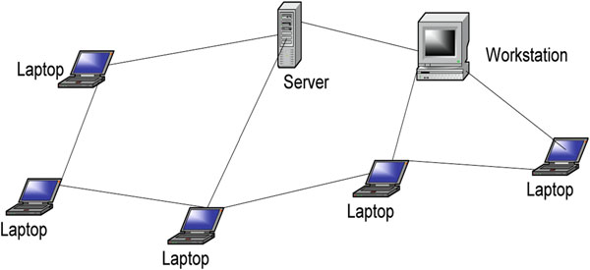
A social network is a theoretical network where each node is an individual, a group, or organization who independently generates, captures, and disseminates information and also serves as a relay for other members of the network. This means that individual nodes must collaborate to propagate the information in the network.
The links between nodes represent relationships and social interactions between individuals, groups, organizations, or even entire societies.

Slide 13
Prehistoric man formed social networks for different reasons including security, access to food, and the social well-being.
Social networks begin with an individual reaching out to another individual or group for a social relationship of sorts, and it snowballs into a mesh of social relationships connecting many individuals and/or groups.
In general, social networks come in all sizes and are self-organizing, complex, and agile depending on the nature of relationships in its links.
As they grow in size, social networks tend to acquire speci fi c elements and traits that make them different.
These traits become more apparent as the network size increases.
The type of social interactions, beliefs, and other traits usually limit the size of the social network.
It is important to note that as the social network grows big, it tends to lose the nuances of a local system; hence, if certain qualities of the network properties are needed, it is better to keep the size under control.

Slide 14
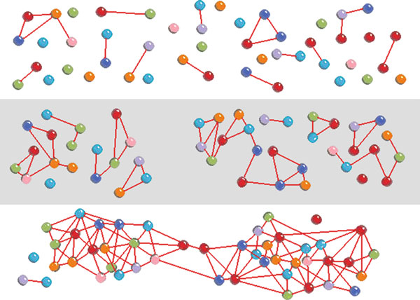

Slide 15
Online social networks (OSNs) are social networks with underlining electronic communication infrastructure links enabling the connection of the interdependencies between the network nodes. The discussion in this chapter will focus on these OSNs. In particular, we will focus on two types of online social networks:
The traditional OSNs such as Facebook and MySpace. Many of these can be accessed via mobile devices without the capability of dealing with mobile content.
The Mobile OSNs (mOSNs) which are newer OSNs that can be accessed via mobile devices and can deal with the new mobile context.
The interdependency between nodes in the OSNs supports social network services among people as nodes.
These interdependencies as relations among people participating in the network services de fi ne the type of OSNs.

Slide 16
Types of Online Social Networks
Chat Network: Although chat rooms by their own nature are public and free for all, some are monitored for specific compliance based usually on attributes like topics under discussion.
Blog Network Another online social network is the bloggers network. “Blogs” are nothing more than people’s online journals. Avid bloggers keep diaries of daily activities. These diaries sometimes are specific on one thread of interest to the blogger or a series of random logs of events during a specific activity. Some blogs are comment on specific topics. Some bloggers have a devoted following depending on the issues
Instant Messaging Network (IMN): Unlike the chat room, however, these exchanges of short messages are private. Like in chat networks, some IMN allow users to keep pro files of themselves

Slide 17
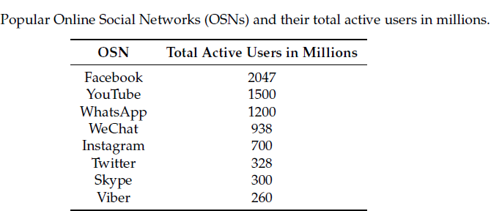
Online Social Networks (OSNs) . These are a combination of all the network types we have discussed above and other highly advanced online features with advanced graphics. There are several of these social networks including Facebook, Twitter, Myspace, Friendster, YouTube, Flickr, and LinkedIn. Srcrds ar f 2018

Slide 18
Most online social network services consist of:
User profile
Social or business links of interests
Additional services

Slide 19
The Growth of Online Social Networks
BITNET was an early world leader in network communications for the research and education communities and helped lay the groundwork for the subsequent introduction of the Internet , especially outside the USA.
Both BITNET and Usenet were invented around the same time in 1981 by Ira Fuchs and Greydon Freeman at the City University of New York (CUNY), where both “store-and forward” networks were.
BITNET was originally named for the phrase “Because It’s There Net,” later updated to “Because It’s Time Net”
It was originally based on IBM’s VNET e-mail system on the IBM virtual machine (VM) mainframe operating system.
BITNET was updated in 1987 to BITNET II to provide a higher bandwidth network similar to the NSFNET
Bulletin Board Services (BBS) . A bulletin board system (BBS) is a software running on a computer allowing users on computer terminals far away to login and access the system services like uploading and downloading files and reading news and contribution of other members through e-mails or public bulletin boards.

Slide 20
LISTSERV. It started in 1986 as an automatic mailing list server software which broadcasts e-mails directed to it to all on the list.
The first LISTSERV was conceived of by Ira Fuchs from BITNET and Dan Oberst from EDUCOM (later EDUCAUSE) and implemented by Ricky Hernandez also of EDUCOM, in order to support research mailing lists on the BITNET academic research network
By the year 2000, LISTSERV ran on computers around the world managing more than 50 thousand lists, with more than 30 million subscribers, delivering more than 20 million messages a day over the Internet

Slide 21
Ethical and Privacy Issues in Online Social Networks
Privacy is a human value consisting of a set of rights including
solitude,
the right to be alone without disturbances;
anonymity,
the right to have no public personal identity;
intimacy,
the right not to be monitored;
the right to control one’s
personal information, including the dissemination methods of that information

Slide 22
With the advent of the Internet, privacy has gained even more value as information has gained value.
The value of privacy comes from its guardianship of the individual’s personal identity and autonomy
Autonomy is important because humans need to feel that they are in control of their destiny.
The less personal information people have about an individual, the more autonomous that individual can be, especially in decision making
People usually tend to establish relationships and associations with individuals and groups that will respect their personal autonomy, especially in decision making.
Personal identity is a valuable source of information.

Slide 23
Privacy Issues in OSNs
Privacy can be violated, anywhere including in online social network communities, through intrusion, misuse of information, interception of information, and information matching
All these privacy issues are
Sharing of personal information with all OSN users
Lack of precise rules by the OSNs on who should use which data
Leakage of private information to third parties
Inter-linkages in OSNs
The presence of a user
Location-based tracking system
Interaction potential between mOSNs and traditional OSNs

Slide 24
Strengthening Privacy in OSNs
Both OSN and mOSN applications should be explicit about which user activities automatically generate events for their activity streams
Users should have control over which events make it into their activity streams and be able to remove events from the streams after they have been added by an application
Users should know who the audience of their activity streams is and should also have control over selecting the audience of their activity streams
Both OSN and mOSN application should create activity stream events which are in sync with user expectation.
Other suggestions that may help in this effort are:
Use secure passwords.
User awareness of the privacy policies and terms of use for their OSNs and mOSNs.
Both OSNs and mOSNs providers should devise policies and enforce existing laws to allow some privacy protection for users while on their networks

Slide 25
Ethical Issues in Online Social Networks
The complexity, unpredictability, and lack of central authority are further enhanced by
Virtual personality
Anonymity
Multiple personality
These three characteristics are at the core of the social and ethical problems in online social networks in particular and cyberspace in general; the larger and more numerous these communities become, the more urgent the ethical concerns become.

Slide 26
Security and Crimes in Online Social Networks
An online crime is a crime like any other crime, except that in this case, the illegal act must involve either an Internet-enabled electronic device or computing system either as an object of a crime, an instrument used to commit a crime, or a repository of evidence related to a crime
Beware of the ways to penetrate crimes in online Social Networks
System Penetration
Distributed Denial of Service
Defense against crimes in OSNs
Prevention which includes Security policy, Vulnerability assessment, Use of strong Cryptographic algorithms, Penetration Testing, Regular Security Audits, Use of proven Security Protocols

Slide 27
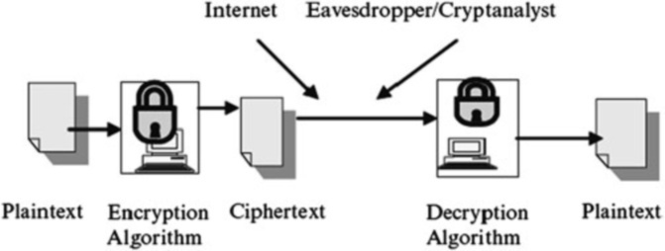
Use of Strong Cryptographic Algorithms
Cryptography is a Greek word meaning “secret writing.” It was used to describe the art of secret communication.

Slide 28
Proven Security Protocols and Best Practices in Online Social Networks
Authentication
Access Control
Legislation
Self-Regulation
Recovery

